Slide 1
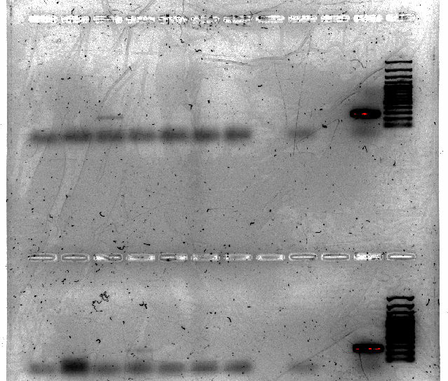
Peas out 7/20 gel 1 (2/26/19)
1 2 3 4 5 6 7 8 9 10 11 12
Well PCR code
1 48
2 49
3 58
4 59
5 60
6 61
7 62
8 nothing
9 -
10 nothing
11 +
12 ladder
13 64
14 65
15 66
16 69
17 71
18 70
19 72
20 nothing
21 -
22 nothing
23 +
24 ladder
13 14 15 16 17 18 19 20 21 22 23 24

Slide 2
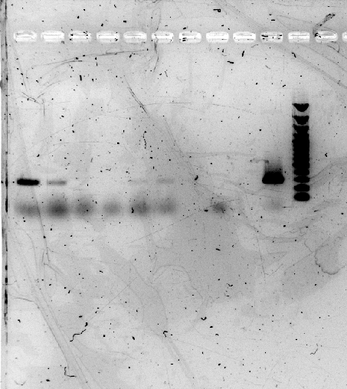
Peas out 7/20 gel 2 (2/26/19)
Well PCR code
1 74
2 75
3 81
4 82
5 83
6 84
7 nothing
8 -
9 nothing
10 +
11 ladder
1 2 3 4 5 6 7 8 9 10 11

Slide 3
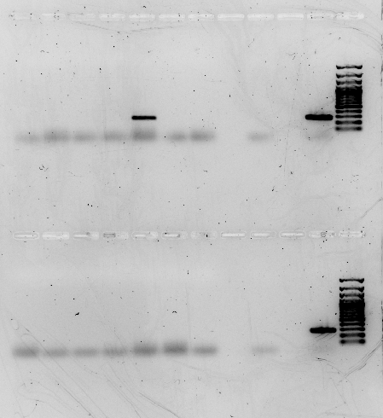
Peas out 7/20 gel 1 (3/6/19)
1 2 3 4 5 6 7 8 9 10 11 12
Well PCR code
1 43
2 41
3 57
4 52
5 78
6 39
7 56
8 nothing
9 -
10 nothing
11 +
12 ladder
13 45
14 79
15 47
16 46
17 44
18 67
19 50
20 nothing
21 -
22 nothing
23 +
24 ladder
13 14 15 16 17 18 19 20 21 22 23 24

Slide 4
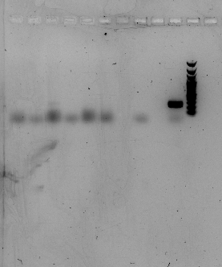
Peas out 7/20 gel 2 (3/6/19)
1 2 3 4 5 6 7 8 9 10 11
Well PCR code
1 54
2 42
3 55
4 51
5 53
6 40
7 nothing
8 -
9 nothing
10 +
11 ladder

